Slide 1




Edunet Foundation | Shell | Artificial Intelligence with Green Technology | 4-weeks Virtual Internship
Shell-Edunet Skills4Future AICTE Internship
Trends of Email Marketing in India
Presented By
TRISHA V
trishavenkatesh113@gmail.com
+91 6369675970
STU66bc04ee35a301723598062

Slide 2

Learning Objectives
To build a comprehensive data analytics solution using Power BI that enables data-driven decision-making. This involves mastering Power BI, importing and cleaning data, establishing relationships, understanding business needs, creating advanced visualizations, and implementing interactive elements. This project use DAX functions to enhance analysis, prepare detailed reports and dashboards, and ensure data accuracy through testing. The ultimate goal is to deliver actionable insights that support business growth.
GOAL
Source :
www.freepik.com/

Slide 3
Tools and Technology used
Requirements:
Datasets – Trends in Email Marketing in India
This dataset should contain data about the email users like type of users, their unique Id, City, State, Pin code and Gender etc.,
Hardware Requirements:
Processor: 1 GHz or faster x86 or x64-bit processor.
Memory (RAM): 4 GB.
Storage: At least 2 GB of available disk space.
Graphics: DirectX 9 or later graphics card with WDDM 1.0 driver.
Software Requirements:
Operating System: Windows 10, Windows 11, or Windows Server (64-bit, .NET 4.7.2 or later required).
Software Application: Power Bi

Slide 4
Methodology
Learn Data Analytics Concepts: Understand basic concepts and their applications.
Master Power BI: Get familiar with Power BI Desktop, Service, and Mobile.
Data Import and Cleaning: Import data and perform cleaning to ensure quality.
Categorize and Wrangle Data: Transform data into a usable format.
Create Relationships: Establish relationships among data tables.
Gather Business Requirements: Collect and document business needs.
Develop DAX Functions: Implement DAX functions for enhanced analysis.
Create Visualizations: Develop advanced visualizations.
Add Interactive Elements: Incorporate filters and slicers.
Prepare Reports and Dashboards: Design and generate comprehensive reports and dashboards.
Test and Validate: Ensure data accuracy and validate outcomes.

Slide 5
Week 1- Importing, Pre-Processing and Data Modelling.
Problem Statement:
Key Concepts
There is a need to develop a foundational understanding of data analytics concepts and gain proficiency in using Power BI. The project will encompass the importation and cleaning of data, establishing relationships between data tables, and understanding business requirements. The primary goal is to transform raw data into actionable insights that support informed decision-making and align with organizational objectives.
Understanding
Cleaning
Modeling

Slide 6
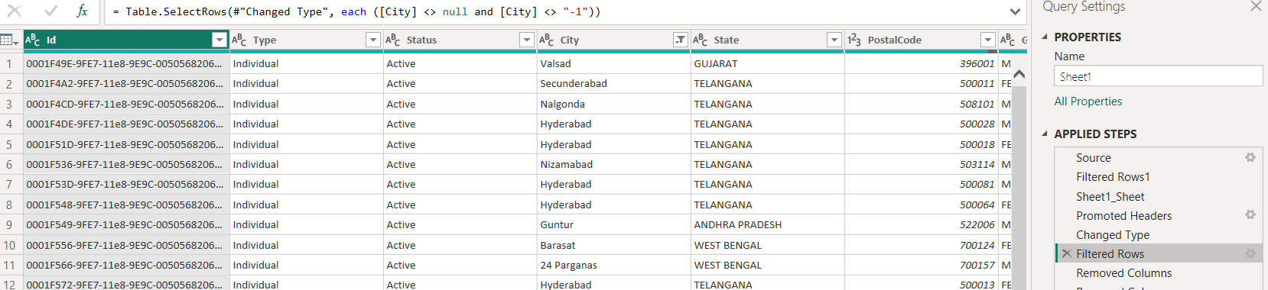
Solution: Data Cleaning

Slide 7
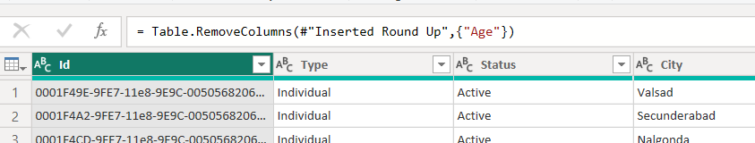
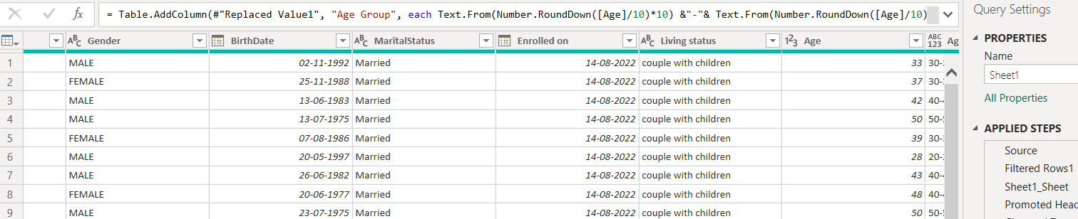
Solution: Data Cleaning

Slide 8
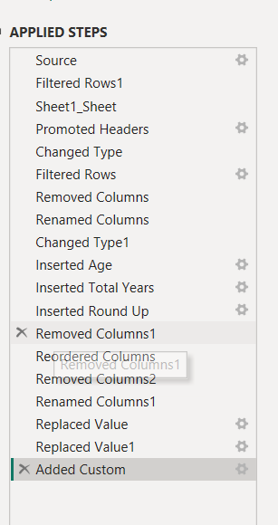
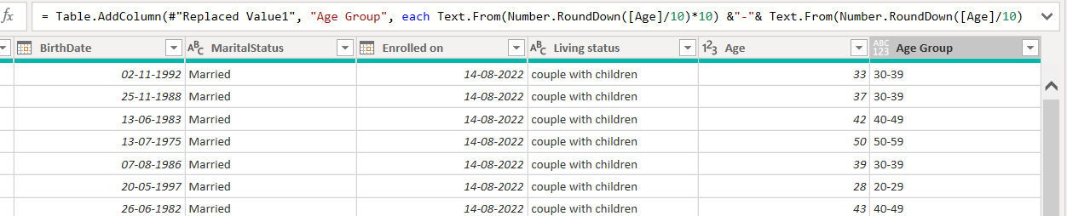
Solution: Data Cleaning

Slide 9
Week 2: DAX and Dashboard(Visualization)
Problem Statement:
Key concepts
Need to develop and implement DAX functions for improved data analysis, create advanced visualizations for better data interpretation, and enhance user interaction through filters, slicers, and other interactive features. Additionally, creating new columns and measures as required and using DAX functions to improve chart functionalities are essential. The goal is to create an interactive, insightful, and user-friendly dashboard for data analytics solution that supports better decision-making.
Year, Month, Day
Interactive dashboard
Dax formulas

Slide 10
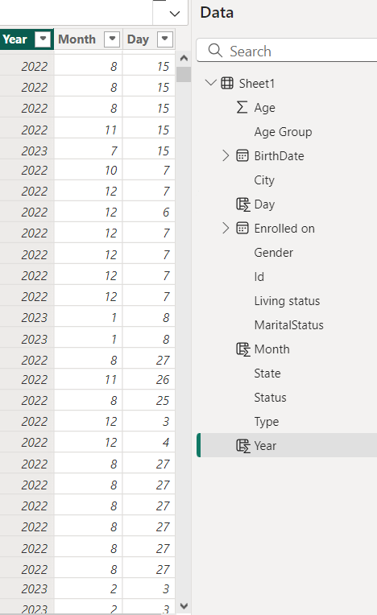
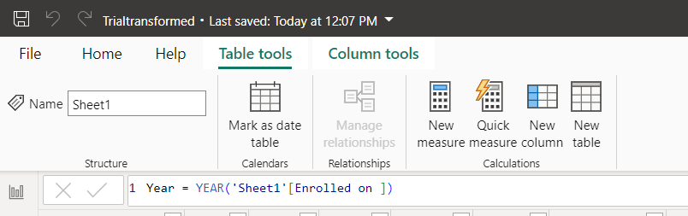
Solution: Adding Year, Month, Day column using DAX Function

Slide 11
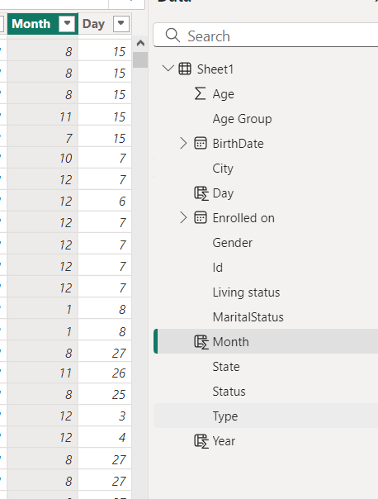
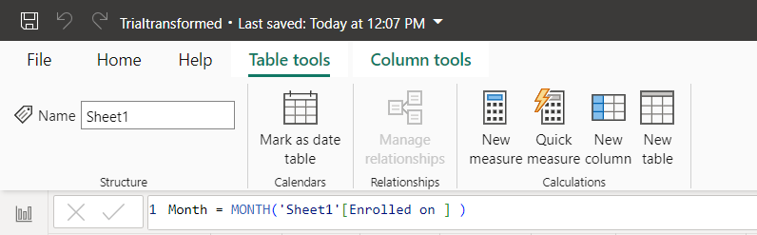
Solution: Adding Year, Month, Day column using DAX Function

Slide 12
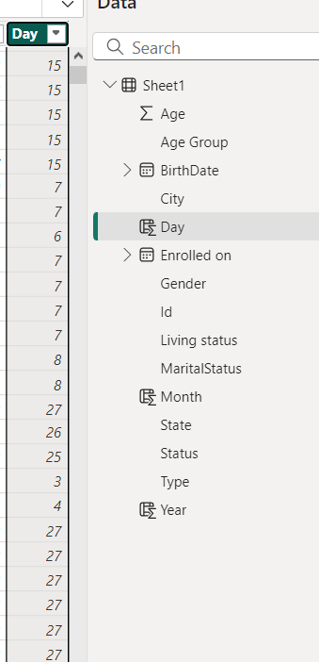
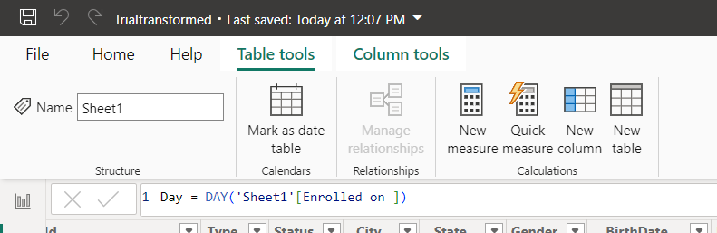
Solution: Adding Year, Month, Day column using DAX Function

Slide 13
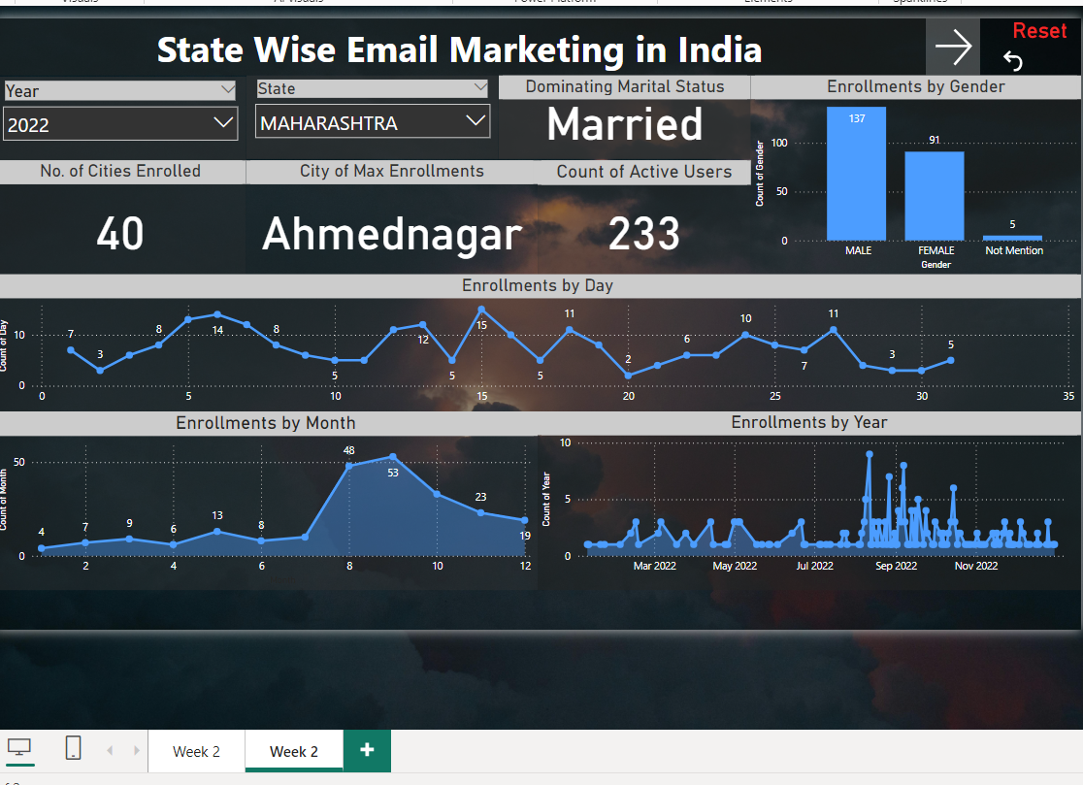
Solution: Week 2 Dashboard

Slide 14
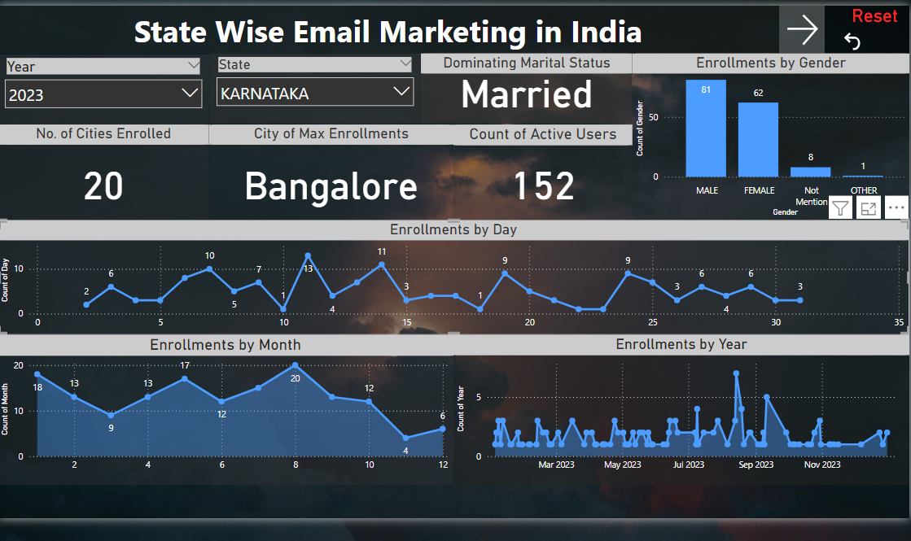
Solution: Week 2 Dashboard

Slide 15
Week 2: DAX and Dashboard(Visualization)
Problem Statement:
Key Concepts
Need to include preparing comprehensive reports, using advanced filtering techniques as needed, and developing an informative dashboard. Additionally, formatting visuals and the canvas background for better readability is crucial. Approaches to testing strategies, cross-checking functionalities, and validating the project outcomes are required to ensure accuracy and reliability. The goal is to create a user-friendly, accurate, and visually appealing data analytics solution that supports informed decision-making.
Mapping
Pie chart
Prediction Forecasting

Slide 16
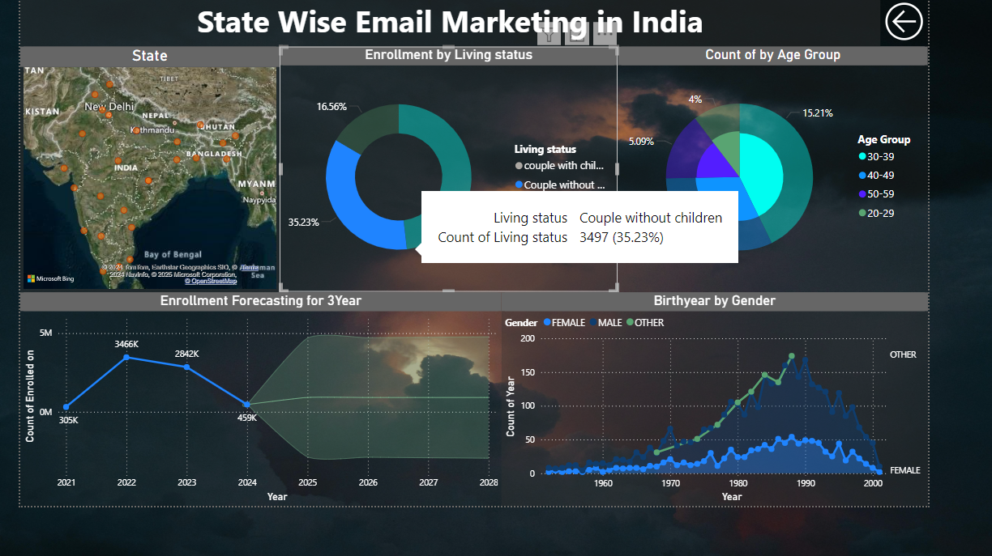
Solution: Final Dashboard

Slide 17
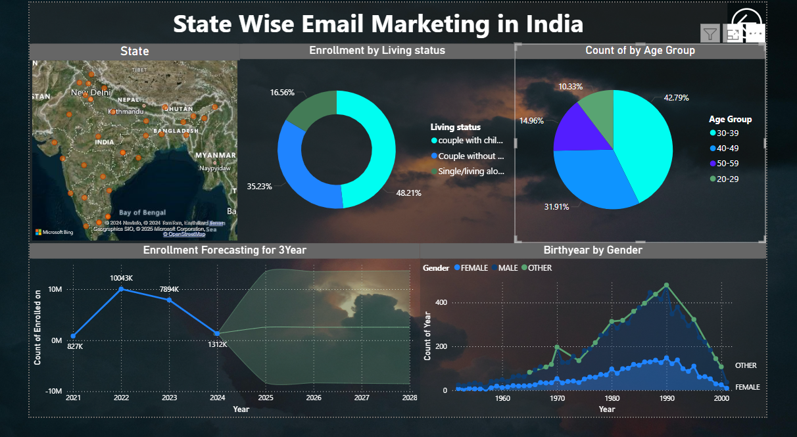
Solution: Final Dashboard

Slide 18
Conclusion:
This project successfully uses Power BI to turn data into valuable insights for better business decisions. We started by learning basic data analytics and mastering Power BI. We imported and cleaned the data, established relationships between data tables, and understood business needs.
We created advanced visualizations, added interactive elements like filters and slicers, and developed detailed reports and dashboards. We ensured the data was accurate through thorough testing and validation.
The result is a user-friendly, reliable, and visually appealing data analytics solution that aligns with business goals and supports informed decision-making.

Slide 19
Thank You
Mentors, Shell and Edunet foundation for giving me this opportunity.
Project Link: https://drive.google.com/file/d/1Rc1urhNFYaAn8anjR0XhCaKaMnjwmg_R/view?usp=drive_link

